Slide 1

GitHub and BitBucket features
CS/IT 490 WD, Fall 2013

Slide 2
Breakdown
Commit History
File Diffs
File Blame
Issue Tracking
Wiki

Slide 3

Commit History
You can view commit history on BitBucket and GitHub by selecting “Commits”
BitBucket
GitHub

Slide 4
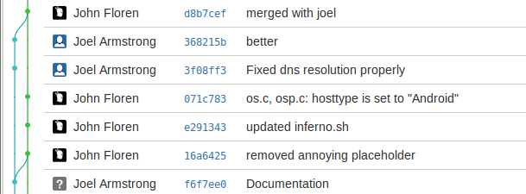
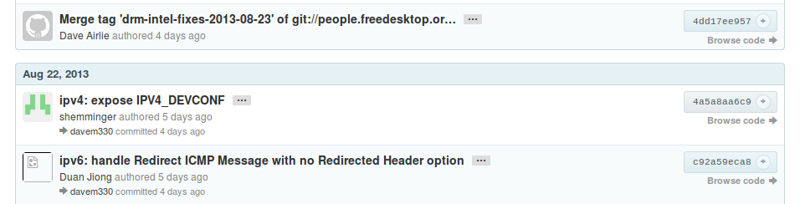
Commit History
This shows you a list of commits
https://bitbucket.org/floren/inferno
https://github.com/torvalds/linux

Slide 5
File Diffs
For BitBucket, select a file in the source browser and click the “Diff” button.
For GitHub, select a file and click “History” and click on a commit hash to view the Diff.
You can also look at Diffs by clicking on a specific Commit in commit history.

Slide 6
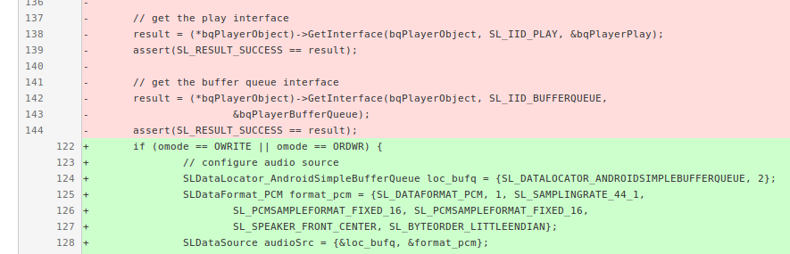
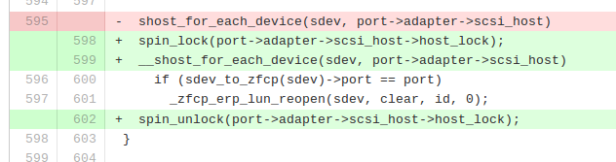
File Diffs
https://bitbucket.org/floren/inferno
https://github.com/torvalds/linux

Slide 7
File Blame
You can also view what was changed on every line of a file with Blame.
In BitBucket, select a file and click “Blame”.
In GitHub, select a file and click “Blame”.

Slide 8
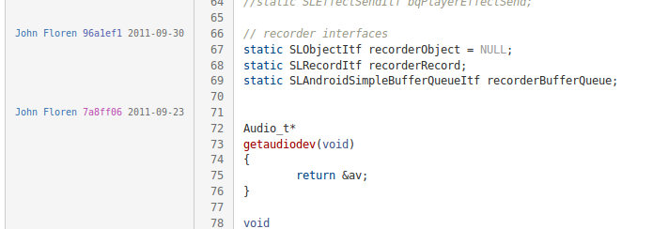
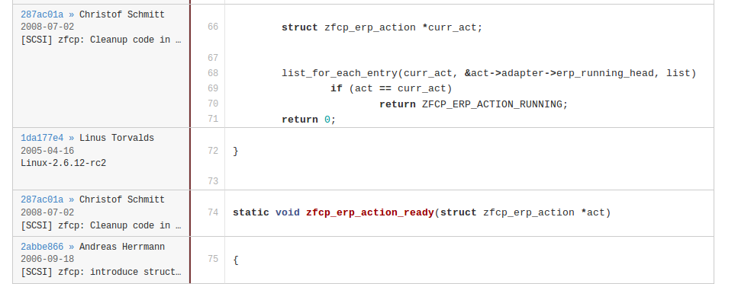
File Blame
https://bitbucket.org/floren/inferno
https://github.com/torvalds/linux

Slide 9
Issue Tracking

Slide 10
Wiki

Slide 11
References
-

